Slide 1
Air Pollution in Nova Scotia
Carlo Carandang
Navjot Kaur
Funto Akinyemi

Slide 2
Air Pollution in NS: Problem
Air Pollution
Detrimental to health (asthma, cancer)
Detrimental to environment
Detrimental to NS economy

Slide 3
Air Pollution in NS: Business Case
Recent push for green and smart cities
NS economy based on tourism and nature
To carry out these green initiatives, Policy Makers need:
accurate and convenient access to current and future air pollution conditions
to highlight pollution problems areas
to measure the effects of interventions to reduce pollution
to predict future pollution problems

Slide 4
2018 Open Data Hackathon
Analyzed air particulate pollution datasets from NS Open Data Portal
Produced time series prediction on concatenated table from the datasets

Slide 5
R Shiny App

Slide 6
Further Analysis of Air Pollution Data
After Hackathon, wanted to further analyze the data
Built a Data Warehouse in Oracle DB for Business Intelligence
Cleaned, extracted, and transformed the data
Loaded the data into a data warehouse
Dimension Tables loading into a Fact Table
Fact table connected directly to Tableau for visualization

Slide 7
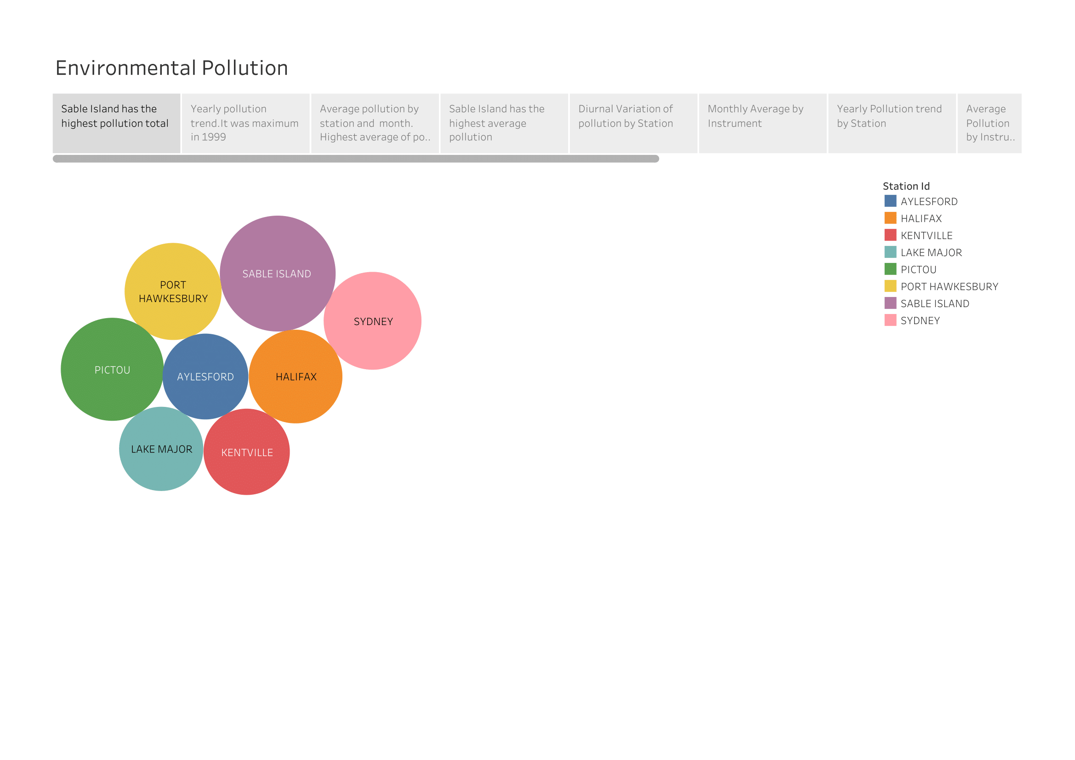

Slide 8
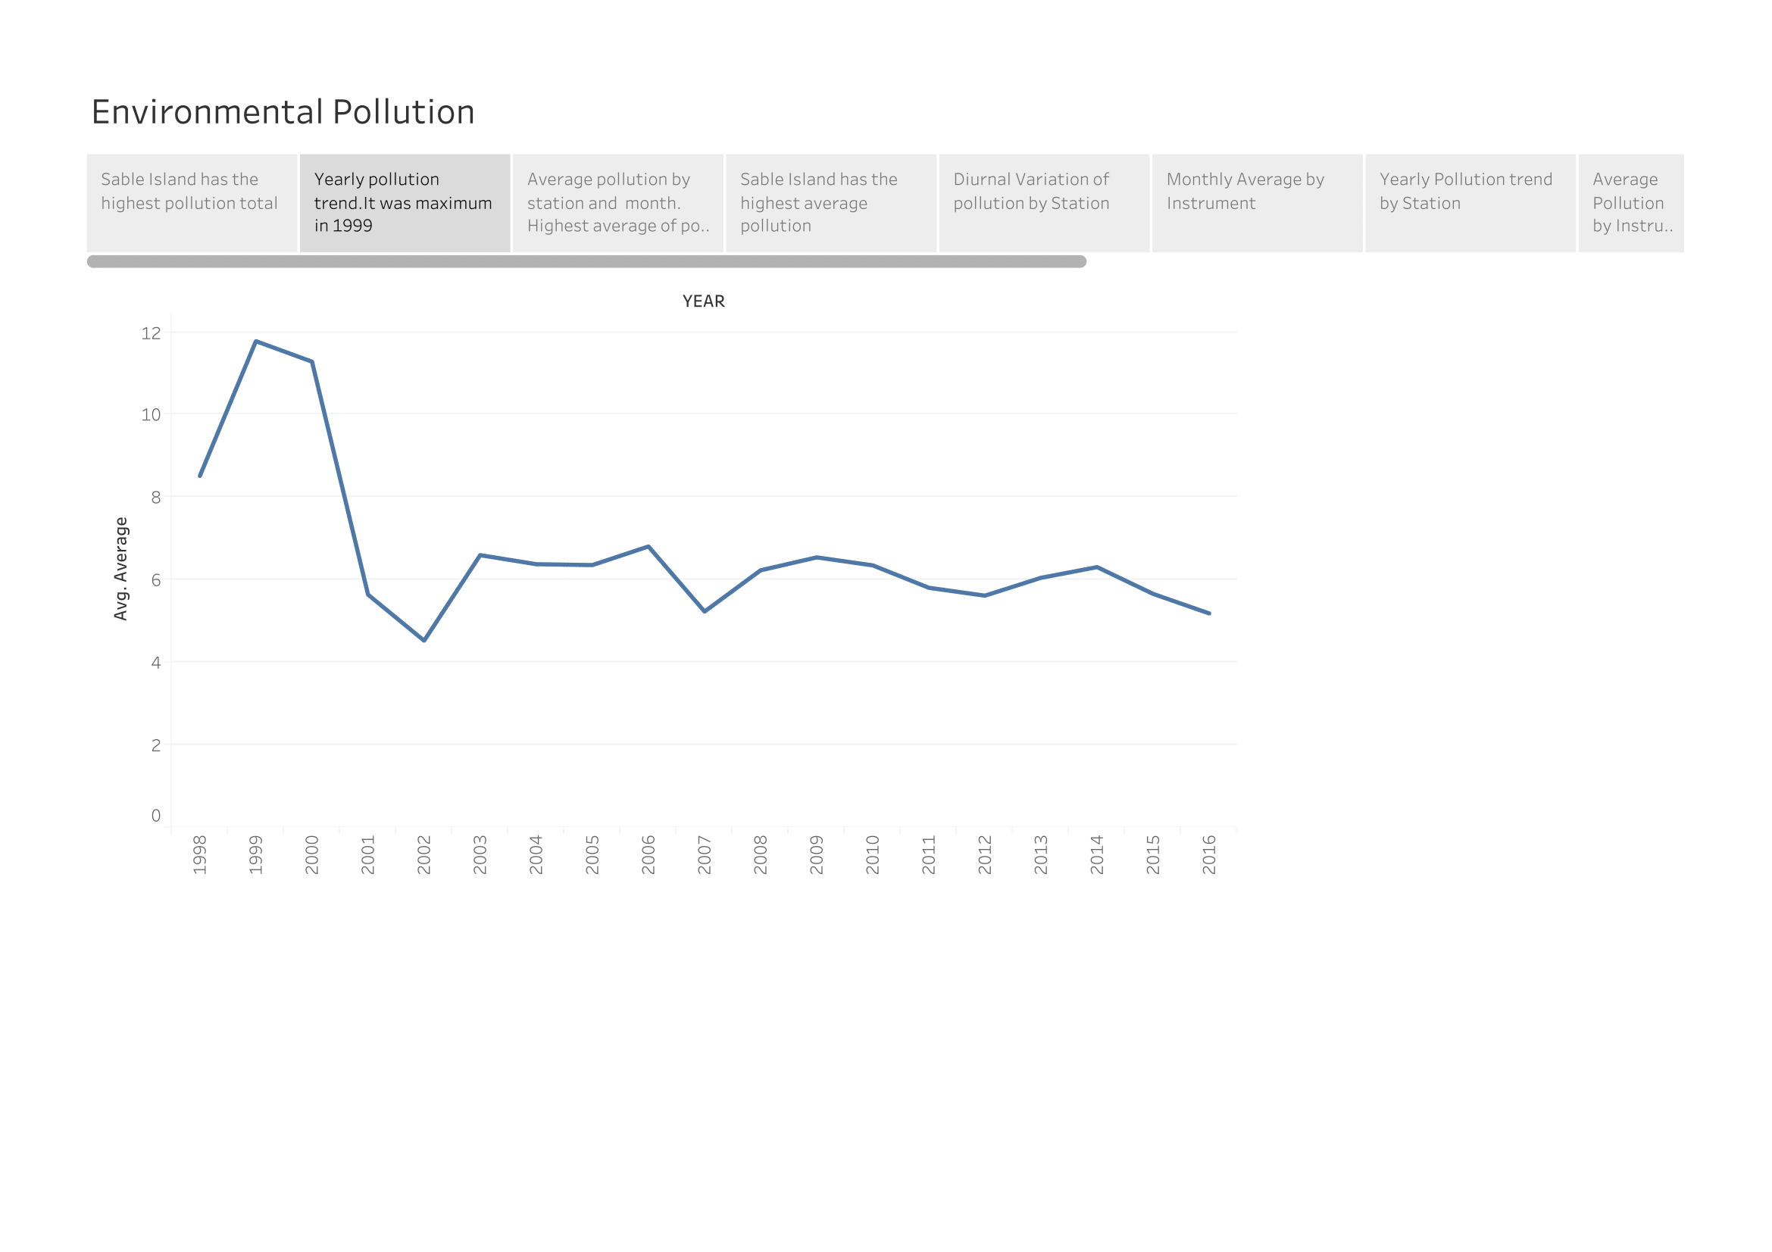

Slide 9
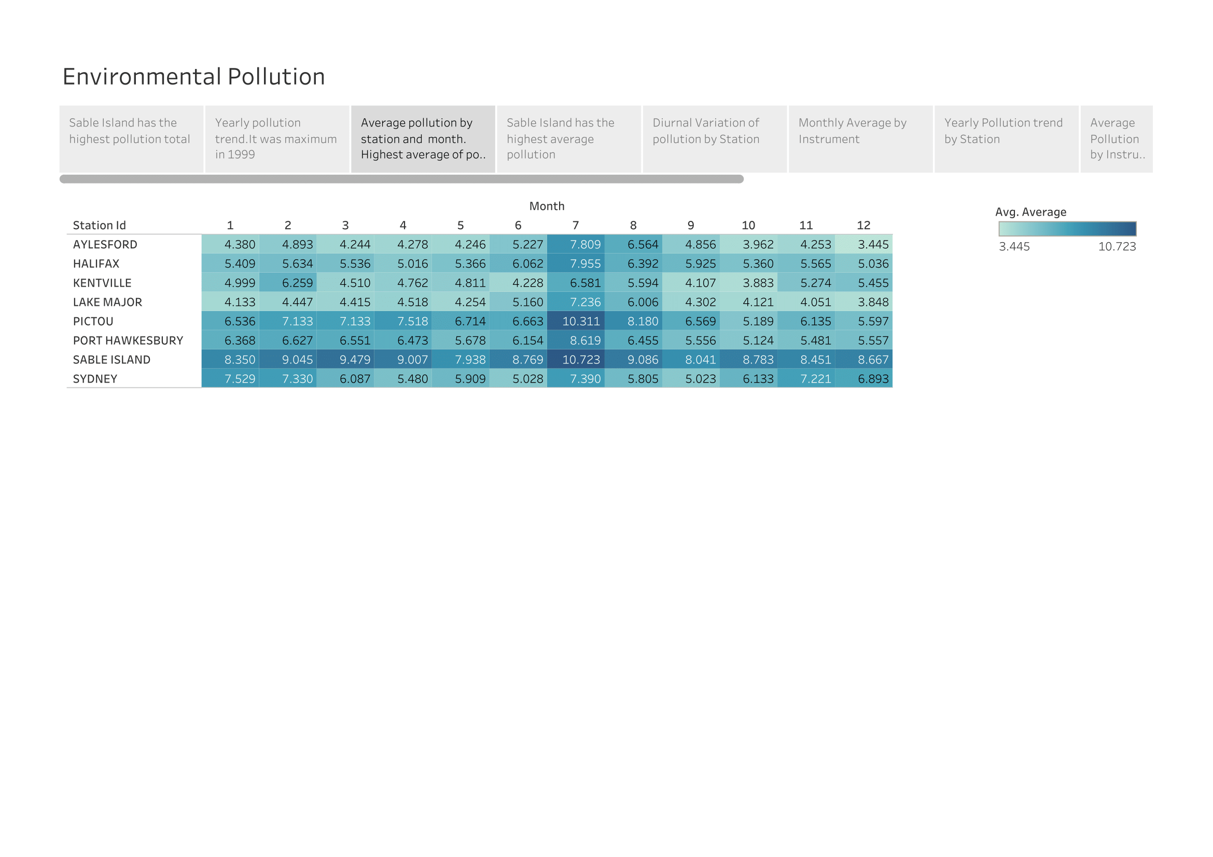

Slide 10
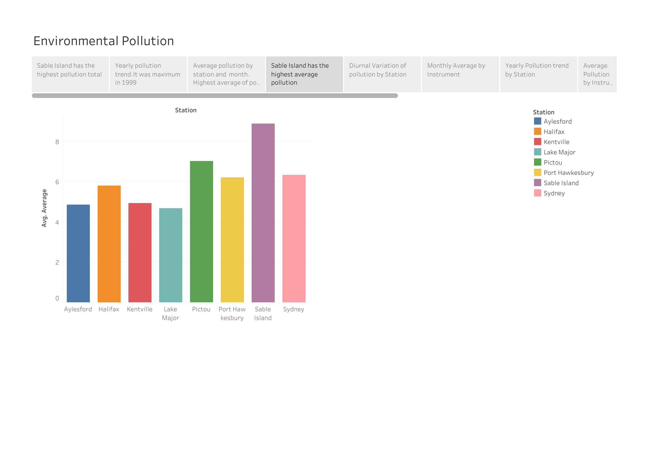

Slide 11
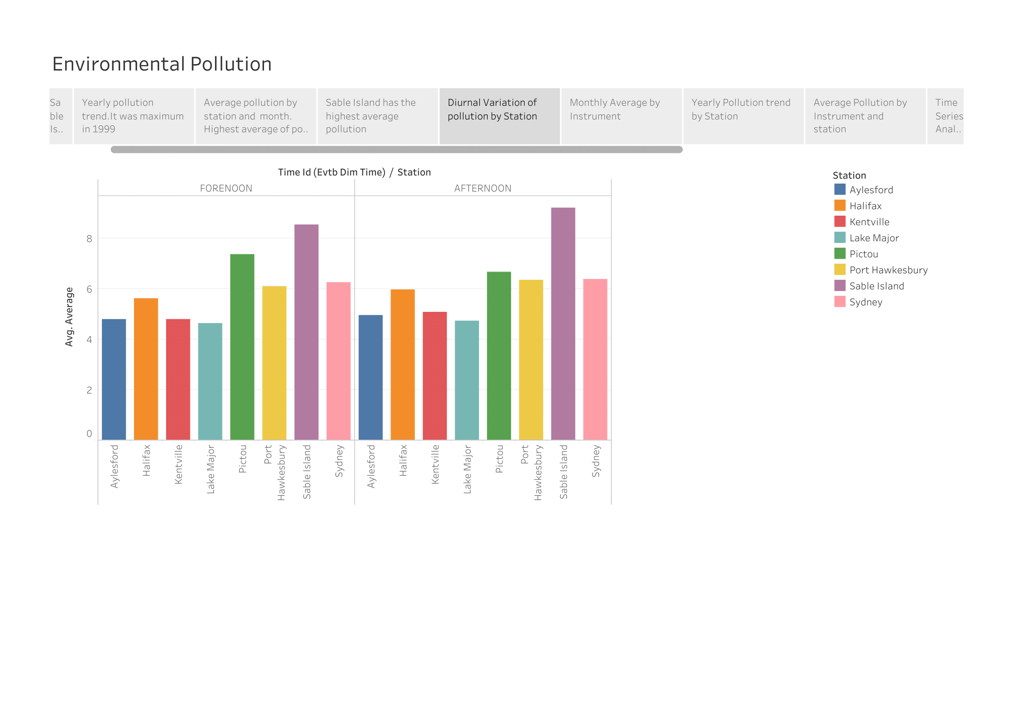

Slide 12
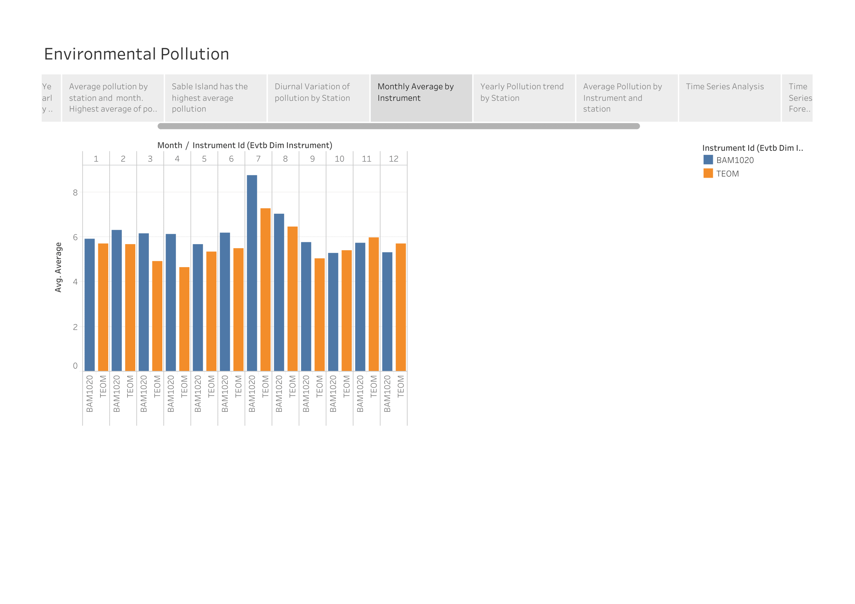

Slide 13
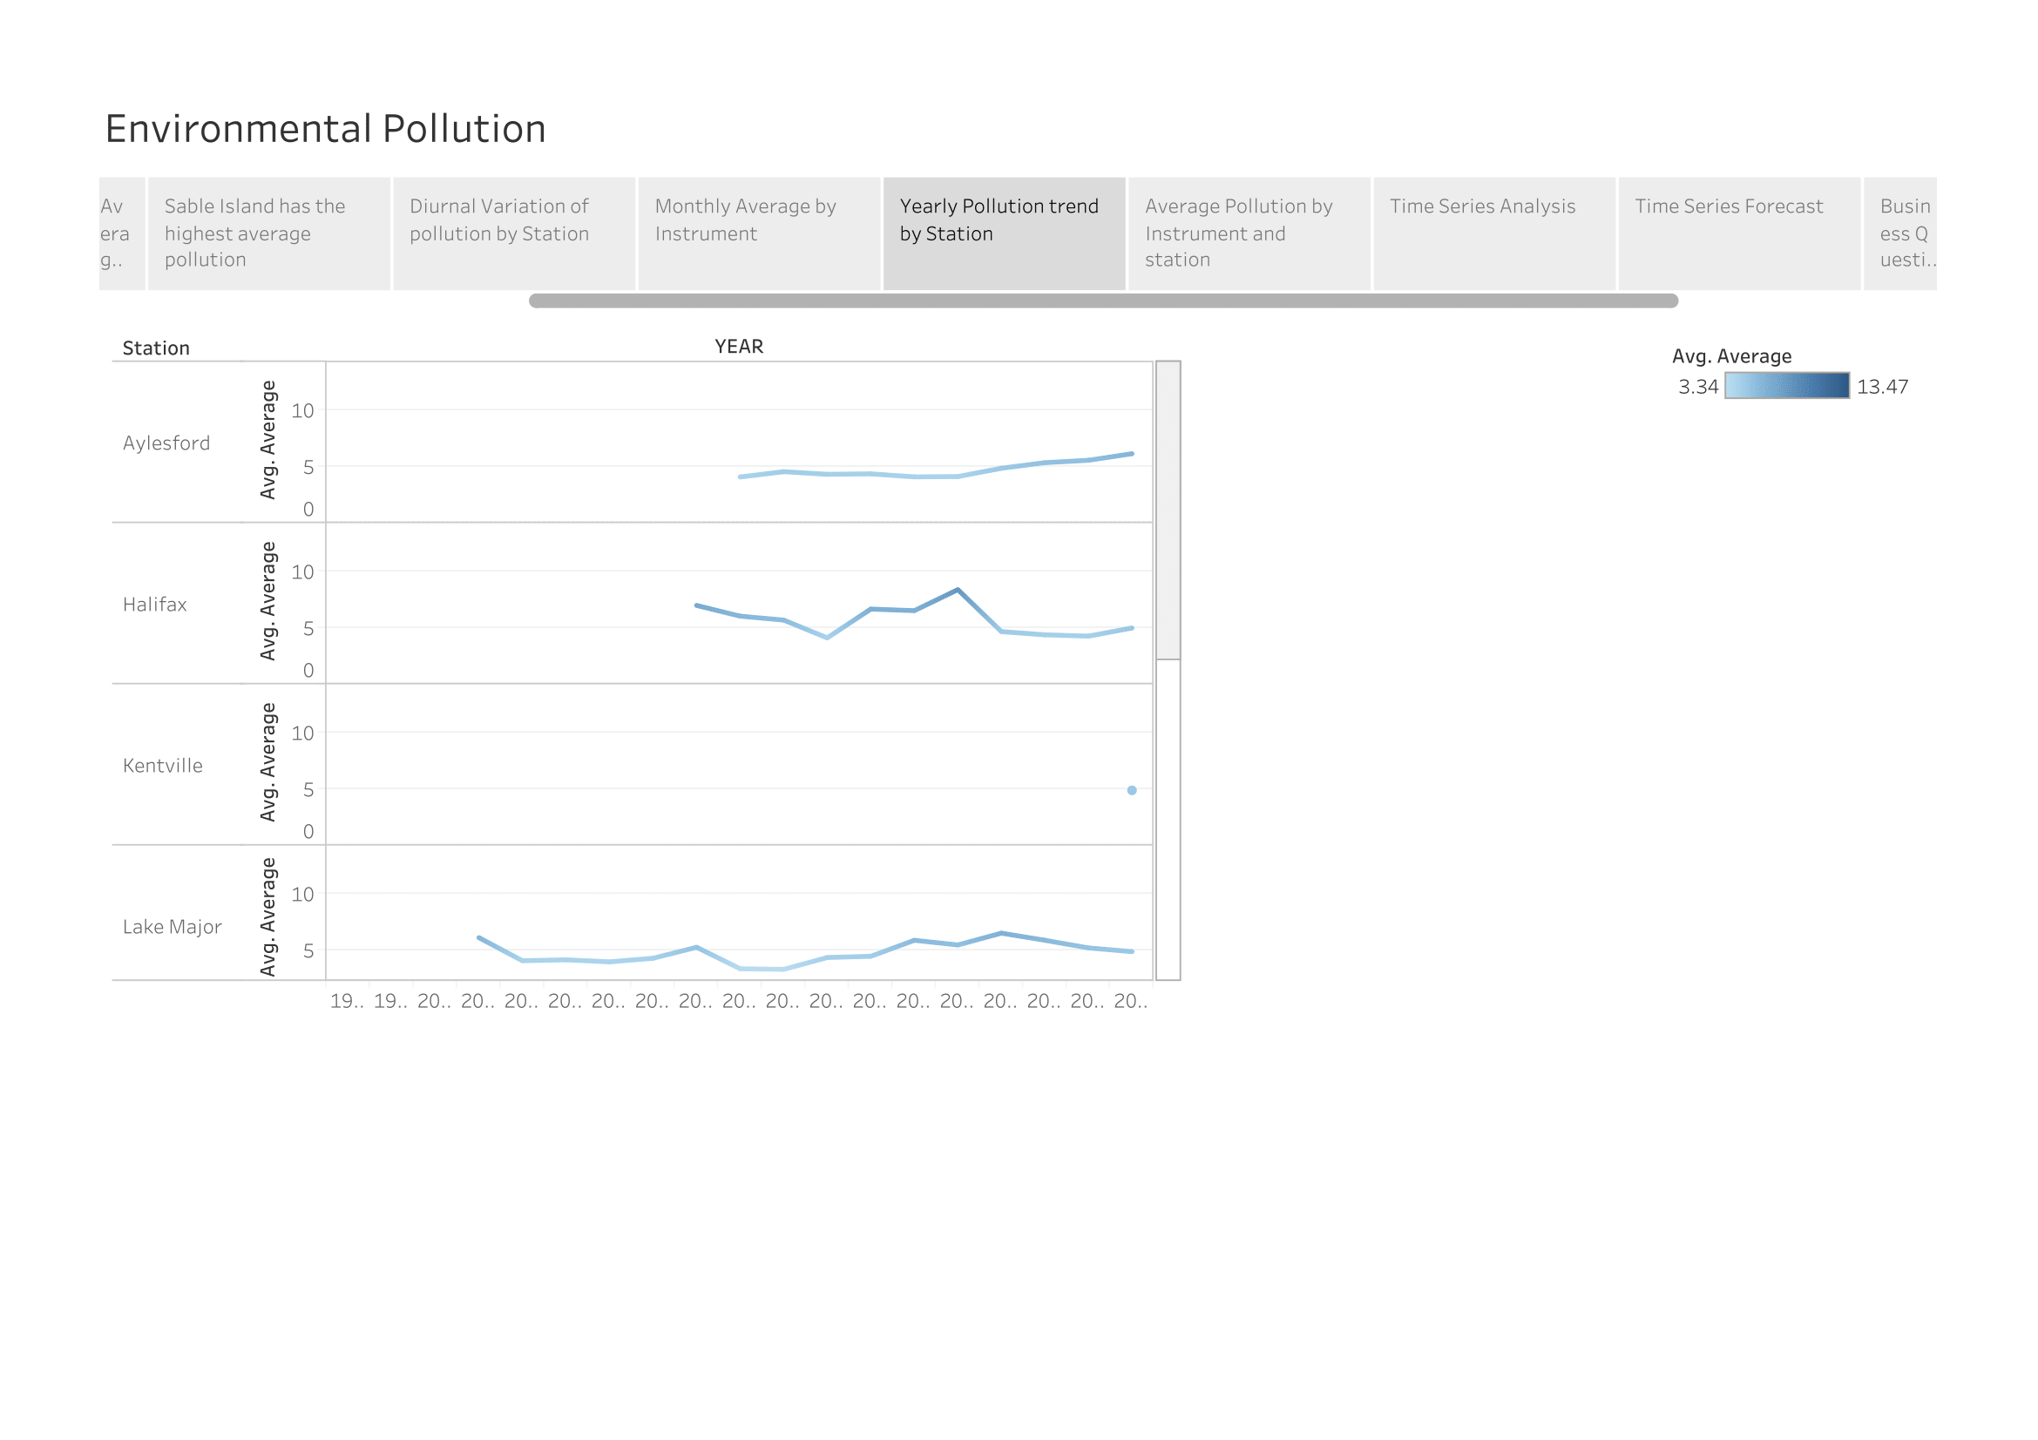

Slide 14
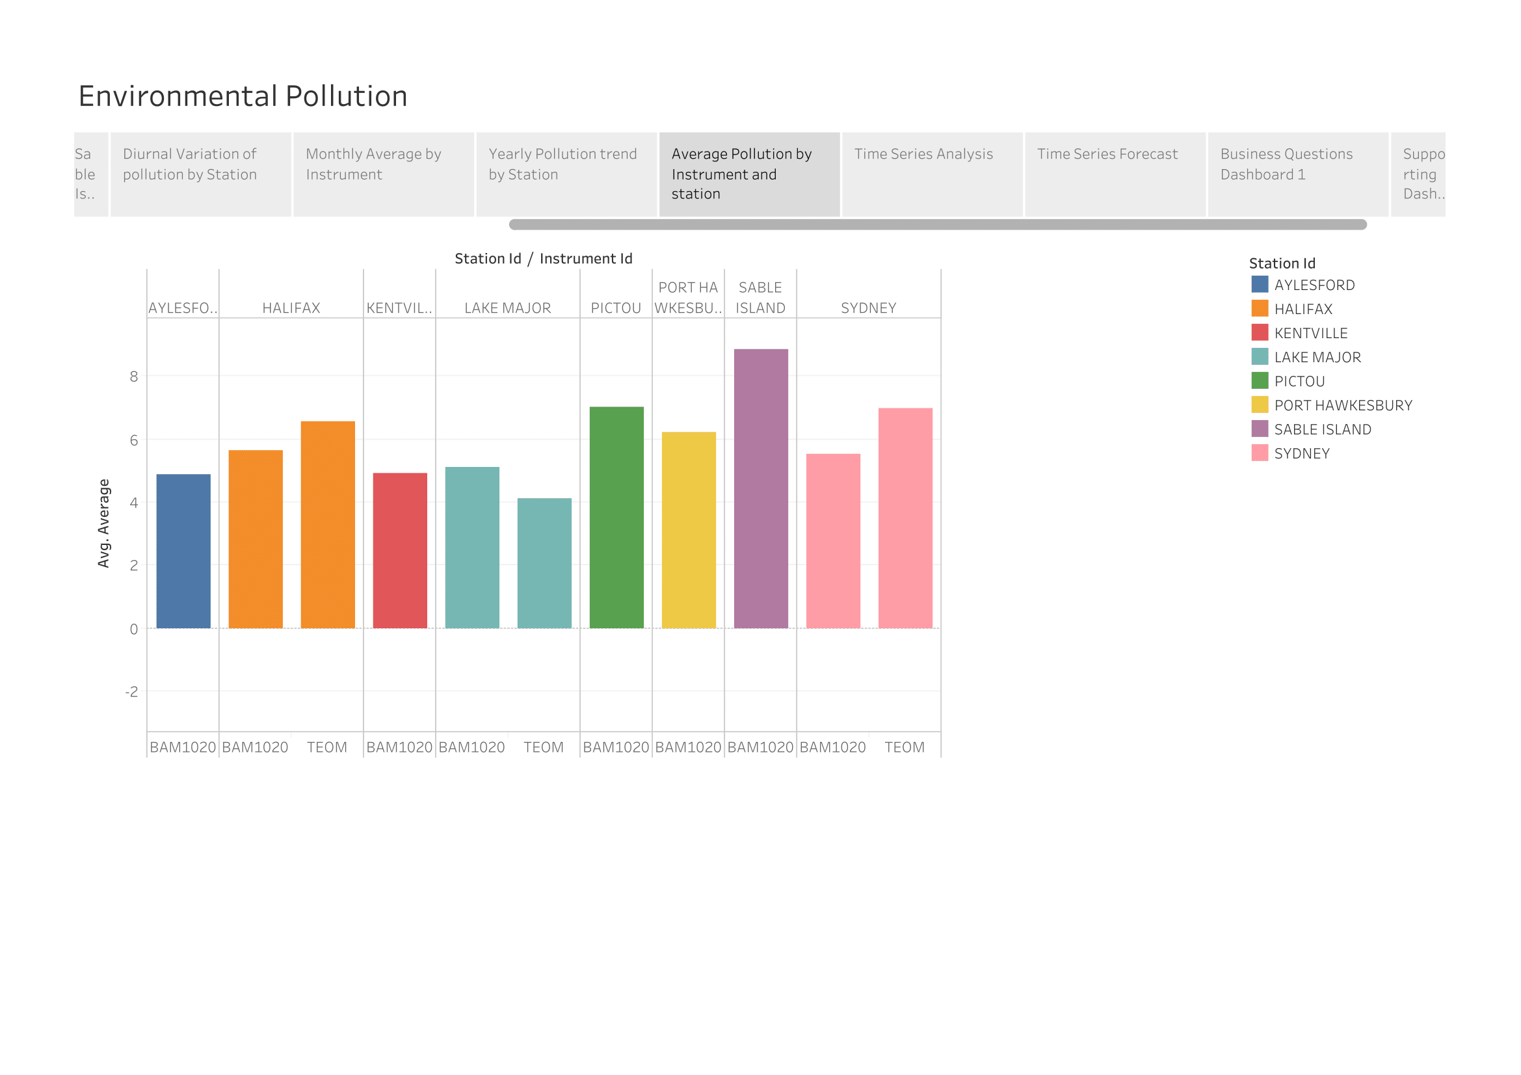

Slide 15
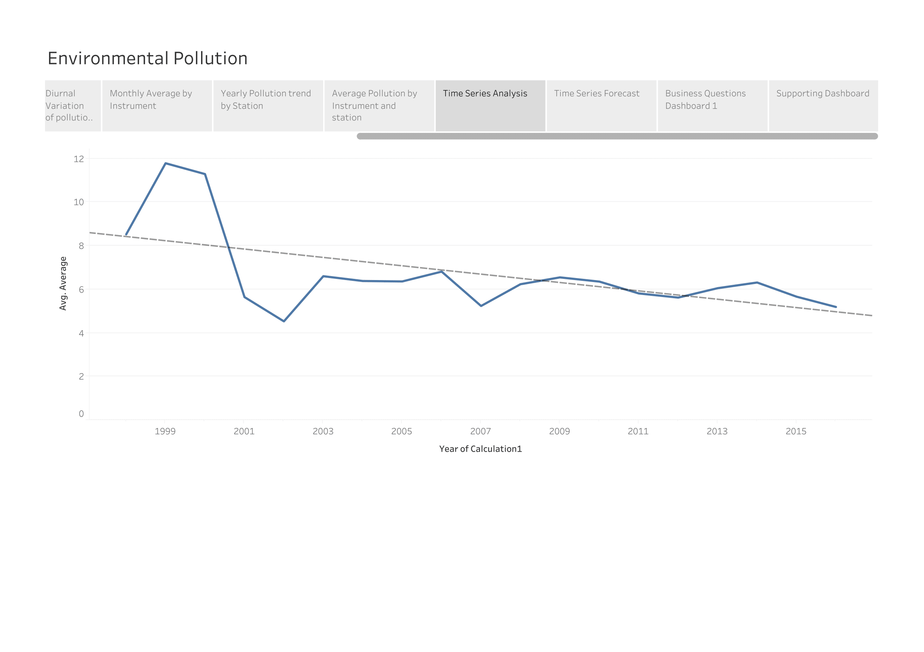

Slide 16
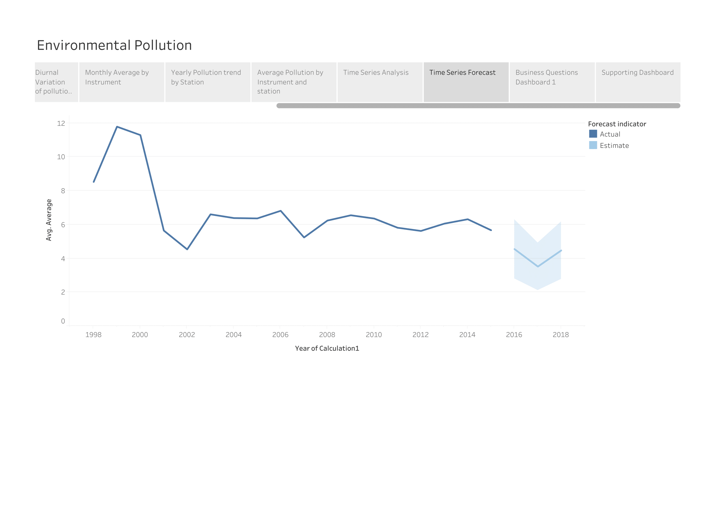

Slide 17
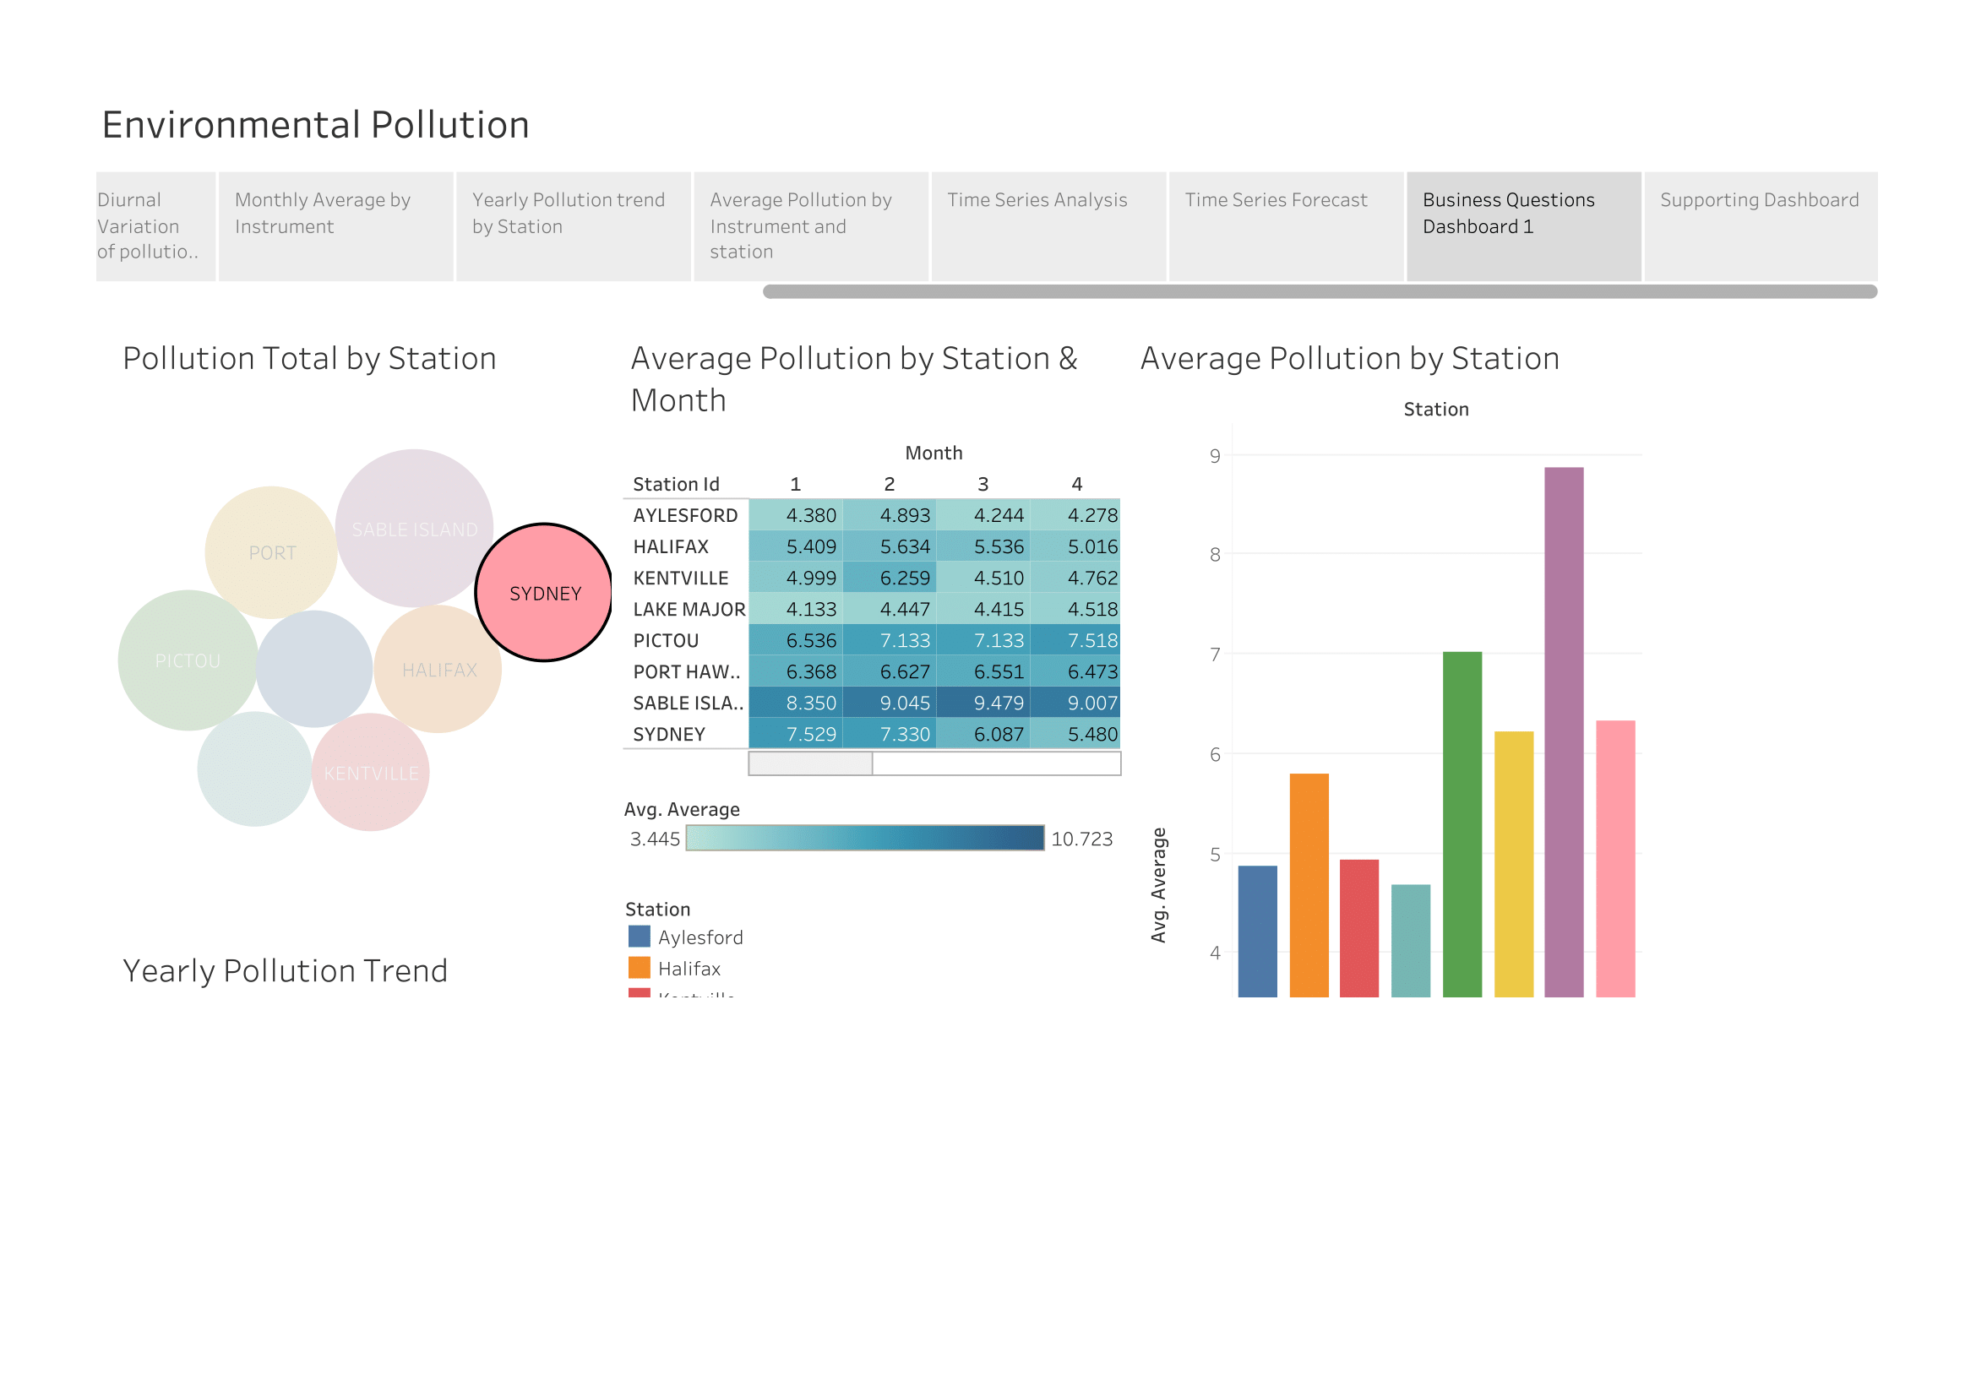

Slide 18
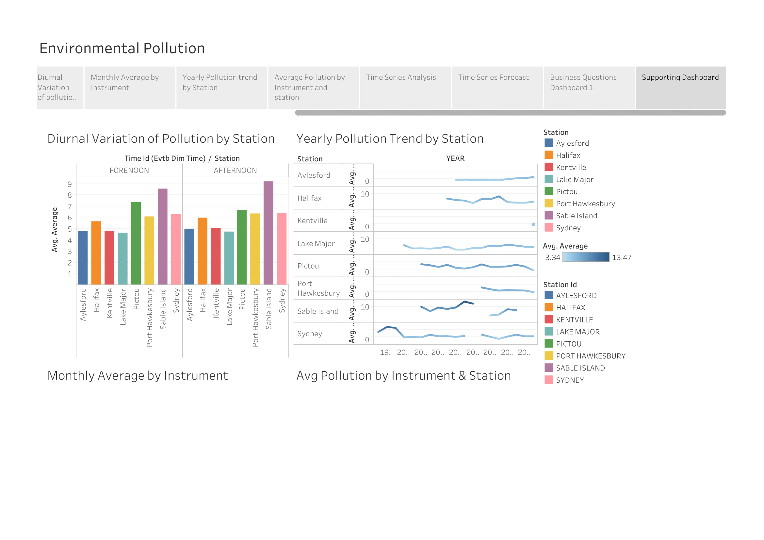

Slide 19
Technical: ETL and Data Warehouse

Slide 20
Technologies
Oracle Database 11g Express Edition Release 11.2.0.2.0 - 64bit Production
Oracle SQL Developer
SQL*Loader
MS Excel
Cloud Dataprep
Tableau
Draw.io

Slide 21
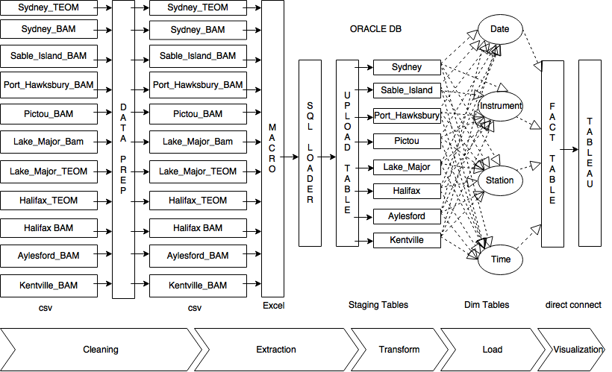

Slide 22
Data Selection: Motivation
We chose these datasets as it contained enough data for us to extract insights into a business problem
When searching, many of the open datasets available had much sparcity or was not populated fully, and also the datasets were small (small number of rows and columns)
We ended up extracting the air particulate pollution datasets from the Nova Scotia Open Data Portal, as there were several dataset on air particulate matter from all around the Province
We chose these datasets as it gave us a chance to extract multiple datasets and perform ETL and analytics on them.

Slide 23
Obtaining the Data
To obtain the data, the following procedure was followed:
Go to https://data.novascotia.ca
Click on button ‘Data Catalogue’
In the search bar, search for ‘pollution air particulate’
You will see 30 results: sort by ‘Most Relevant’
You want the first 12 results (ignore the 11th result, which is a lookup table)
This will leave you with 11 csv files for analysis.

Slide 24
csv Description: 44 MB; 643,453 rows total
Nova_Scotia_Provincial_Ambient_Fine_Particulate_Matter__Kentville_BAM.csv 498 KB 8,785 rows
Nova_Scotia_Provincial_Ambient_Fine_Particulate_Matter__Halifax_BAM.csv 4.7 MB 69,958 rows
Nova_Scotia_Provincial_Ambient_Fine_Particulate_Matter__Port Hawkesbury_BAM.csv 4.1 MB 55,559 rows
Nova_Scotia_Provincial_Ambient_Fine_Particulate_Matter__Sable_Island_BAM.csv 4.6 MB 64,496 rows
Nova_Scotia_Provincial_Ambient_Fine_Particulate_Matter__Pictou_BAM.csv 6.8 MB 104,033 rows
Nova_Scotia_Provincial_Ambient_Fine_Particulate_Matter__Sydney_BAM.csv 3.4 MB 50,752 rows
Nova_Scotia_Provincial_Ambient_Fine_Particulate_Matter__Lake_Major_TEOM.csv 4 MB 60,691 rows
Nova_Scotia_Provincial_Ambient_Fine_Particulate_Matter__Halifax_TEOM.csv 790 KB 12,494 rows
Nova_Scotia_Provincial_Ambient_Fine_Particulate_Matter__Aylesford_BAM.csv 4.7 MB 68,025 rows
Nova_Scotia_Provincial_Ambient_Fine_Particulate_Matter__Lake_Major_BAM.csv 6.7 MB 96,433 rows
Nova_Scotia_Provincial_Ambient_Fine_Particulate_Matter__Sydney_TEOM.csv 3.8 MB 60,514 rows

Slide 25
Data Description
Column Sample Data Description
Date_Time 07/24/1998 03:00:00 PM date-time stamp
Pollutant PM2.5 fine particulate matter
Unit ¬µg/m3 micrograms per cubic metre
Station Sydney location of instrument
Instrument TEOM instrument type
Average 24 average concentration

Slide 26
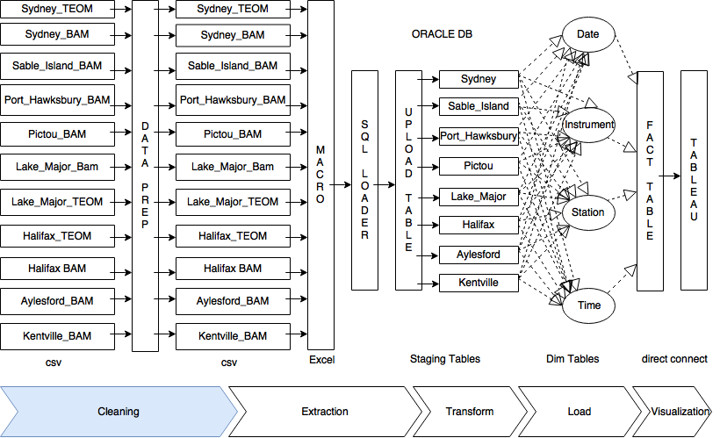

Slide 27
Cleaning
We chose to perform preprocessing of the data in Cloud Dataprep. We uploaded the 11 csv files that were extracted from the Nova Scotia Open Data Portal

Slide 28
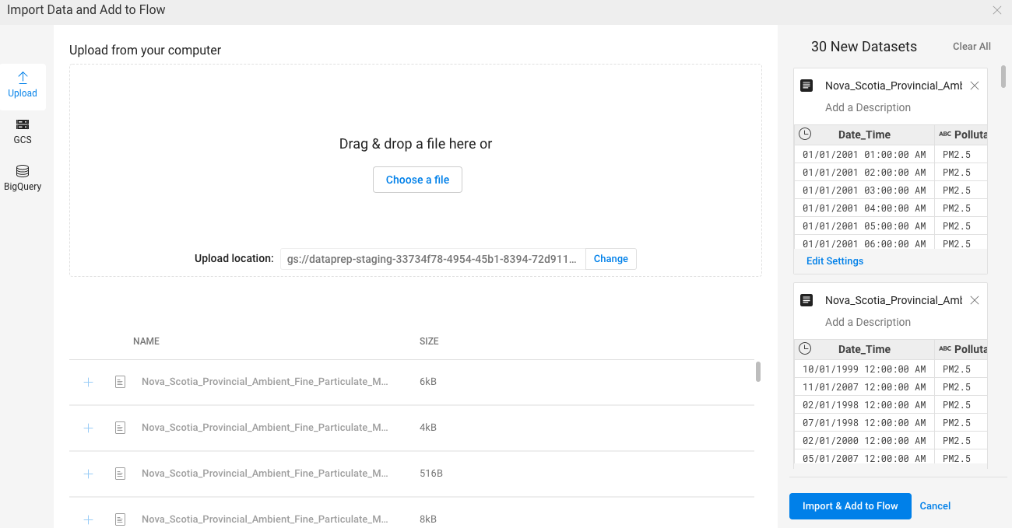
Import the Data and Add to Flow

Slide 29
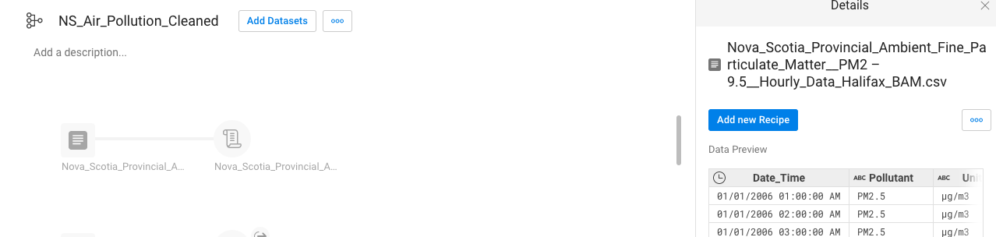
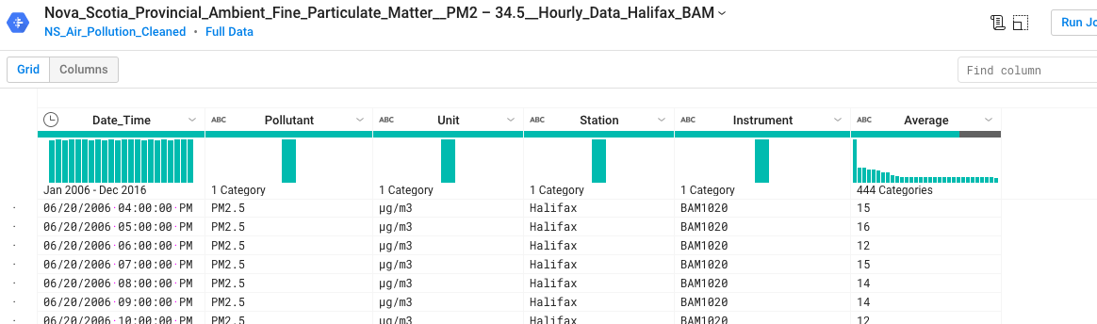
Recipe to Remove Rows with Null Values

Slide 30
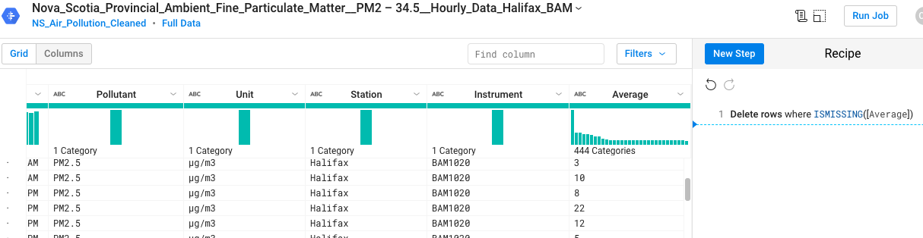
Remove Rows with Null Values

Slide 31
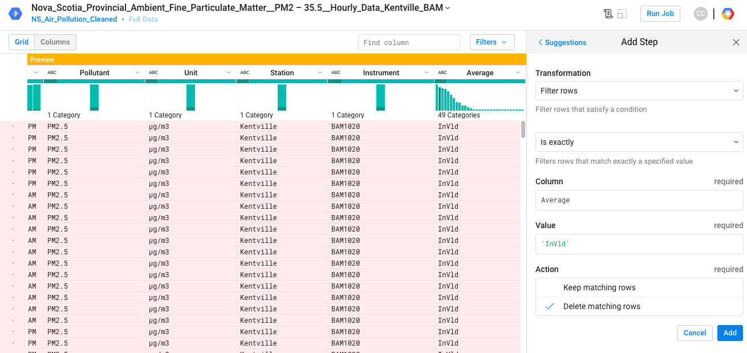
Remove Rows with ‘InVld’

Slide 32
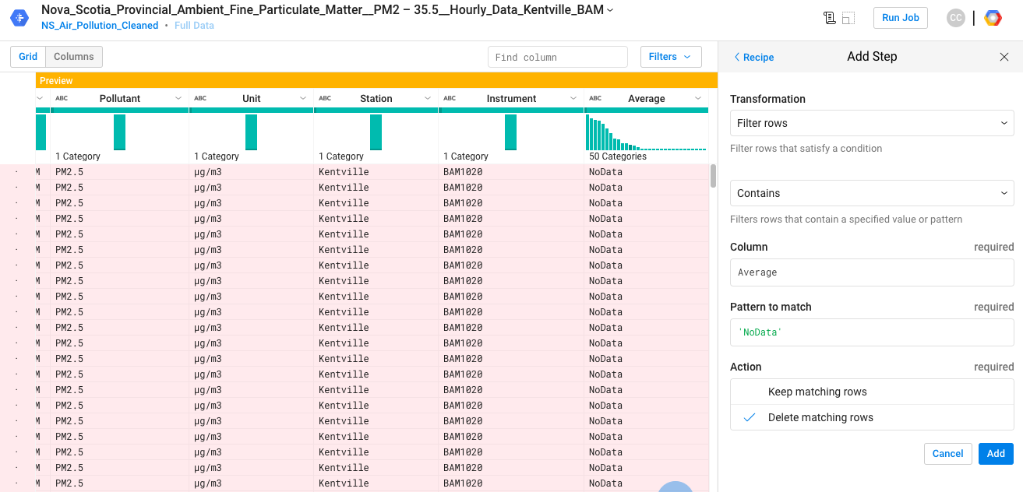
Remove Rows with ‘NoData’

Slide 33
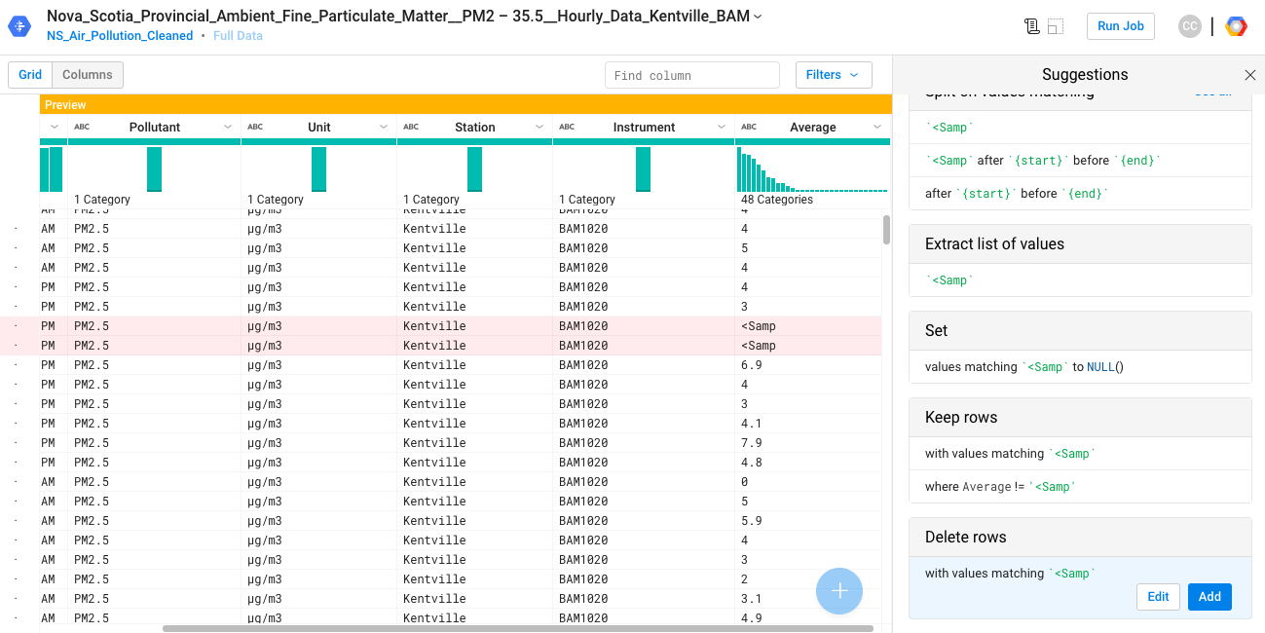
Remove Rows with ‘<Samp’

Slide 34
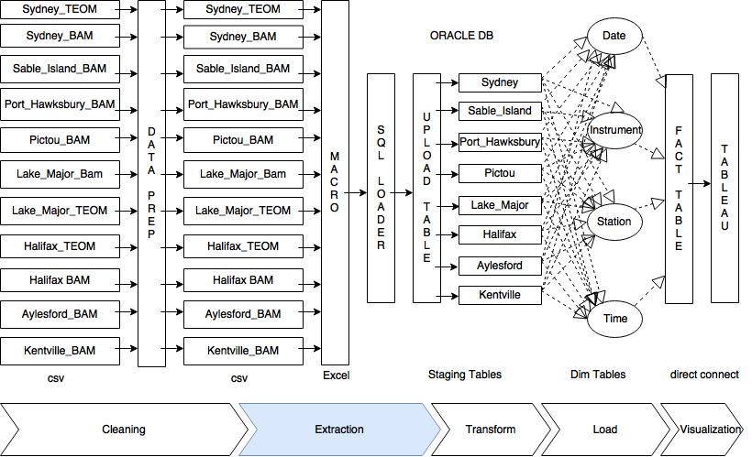

Slide 35
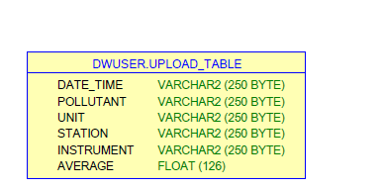
Extraction: csv to staging tables
-- Extract csv to staging tables via Excel Macro using SQL Loader.
-- First, create upload table:
CREATE TABLE "DWUSER"."UPLOAD_TABLE"
( "DATE_TIME" VARCHAR2(250 BYTE),
"POLLUTANT" VARCHAR2(250 BYTE),
"UNIT" VARCHAR2(250 BYTE),
"STATION" VARCHAR2(250 BYTE),
"INSTRUMENT" VARCHAR2(250 BYTE),
"AVERAGE" FLOAT(126) ) ;

Slide 36
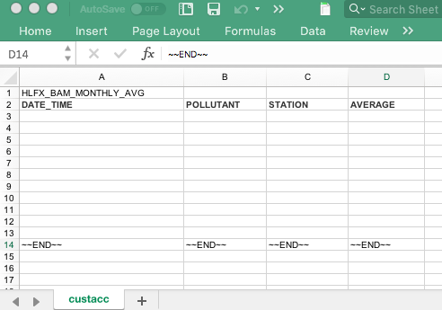
Extraction: csv to staging tables
Next, utilize Excel Macro to load csv’s via SQL Loader:

Slide 37
Extraction: csv to staging tables
-- Run SQL*Loader via control files, in conjunction with Excel Macros:
LOAD DATA
INFILE *
APPEND
INTO TABLE HLFX_BAM_MONTHLY_AVG
Fields terminated by '~'
Trailing Nullcols
(DATE_TIME,POLLUTANT,STATION,AVERAGE)
BEGINDATA
9-Jan-2008~PM2.5~Halifax~4.814259
-- Load all 11 csv files via this method

Slide 38
Testing
Log file of initial extraction of csv files into Oracle DB table:
SQL*Loader: Release 11.2.0.2.0 - Production on Fri Mar 9 14:05:54 2018 Copyright (c) 1982, 2009, Oracle and/or its affiliates. All rights reserved. Control File: C:\JUNK\INTREVERSE.CTL Data File: C:\JUNK\INTREVERSE.CTL Bad File: C:\JUNK\INTREVERSE.bad Discard File: none specified (Allow all discards)
Number to load: ALL Number to skip: 0 Errors allowed: 50 Bind array: 64 rows, maximum of 256000 bytes Continuation: none specified Path used: Conventional

Slide 39
Testing: continued
Table HLFX_BAM_MONTHLY_AVG, loaded from every logical record. Insert option in effect for this table: APPEND TRAILING NULLCOLS option in effect Column Name Position Len Term Encl Datatype ------------------------------ ---------- ----- ---- ---- --------------------- DATE_TIME FIRST * ~ CHARACTER POLLUTANT NEXT * ~ CHARACTER STATION NEXT * ~ CHARACTER AVERAGE NEXT * ~ CHARACTER Table HLFX_BAM_MONTHLY_AVG: 132 Rows successfully loaded. 0 Rows not loaded due to data errors. 0 Rows not loaded because all WHEN clauses were failed. 0 Rows not loaded because all fields were null.

Slide 40
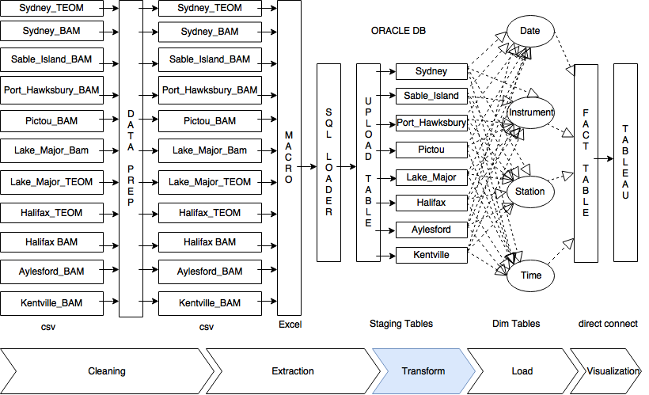

Slide 42
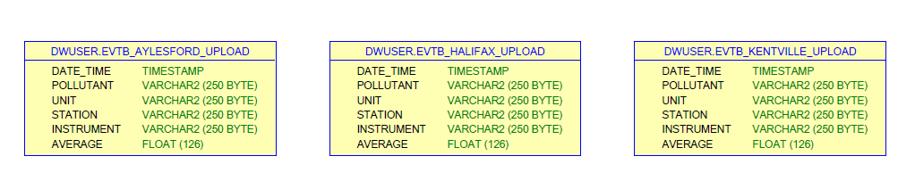
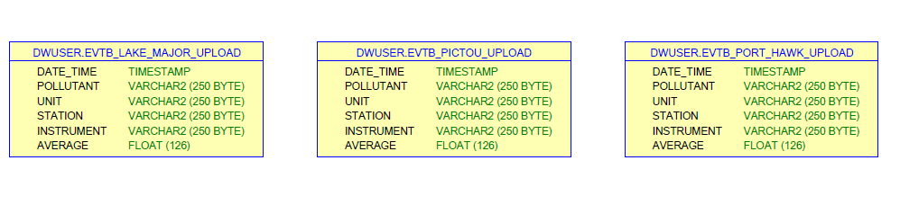
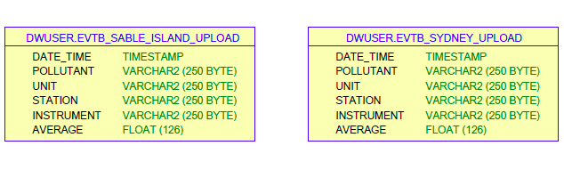

Slide 43
Transformation
-- Upload table transformed into tables partitioned by Station (location):
CREATE TABLE "DWUSER"."EVTB_HALIFAX_UPLOAD"
( "DATE_TIME" TIMESTAMP (6),
"POLLUTANT" VARCHAR2(250 BYTE),
"UNIT" VARCHAR2(250 BYTE),
"STATION" VARCHAR2(250 BYTE),
"INSTRUMENT" VARCHAR2(250 BYTE),
"AVERAGE" FLOAT(126));
-- Repeat this for the 7 other Station Locations

Slide 44
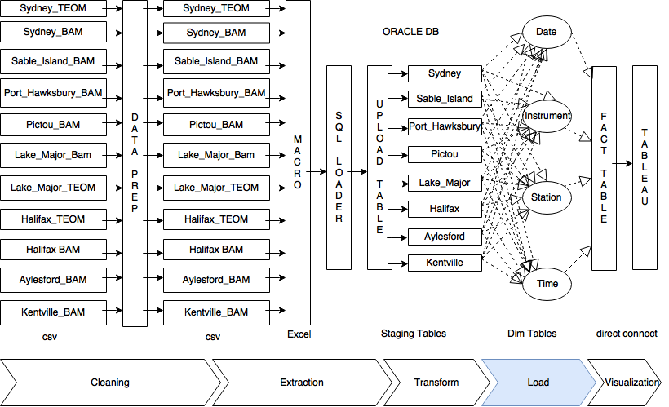

Slide 45
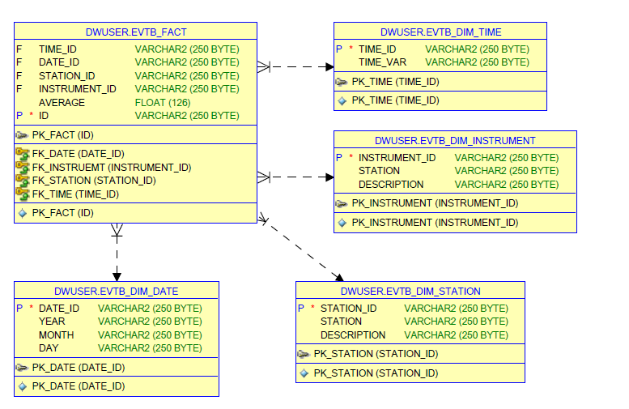

Slide 46
Load Dim Tables and Fact Table
CREATE TABLE "DWUSER"."EVTB_FACT"
( "TIME_ID" VARCHAR2(250 BYTE),
"DATE_ID" VARCHAR2(250 BYTE),
"STATION_ID" VARCHAR2(250 BYTE),
"INSTRUMENT_ID" VARCHAR2(250 BYTE),
"AVERAGE" FLOAT(126),
"ID" VARCHAR2(250 BYTE),
CONSTRAINT "PK_FACT" PRIMARY KEY ("ID"));

Slide 47
Load Dim Tables and Fact Table
CREATE TABLE "DWUSER"."EVTB_DIM_STATION"
( "STATION_ID" VARCHAR2(250 BYTE),
"STATION" VARCHAR2(250 BYTE),
"DESCRIPTION" VARCHAR2(250 BYTE),
CONSTRAINT "PK_STATION" PRIMARY KEY ("STATION_ID"));
-- Repeat this for DIM_DATE, DIM_INSTRUMENT, and DIM_TIME

Slide 48
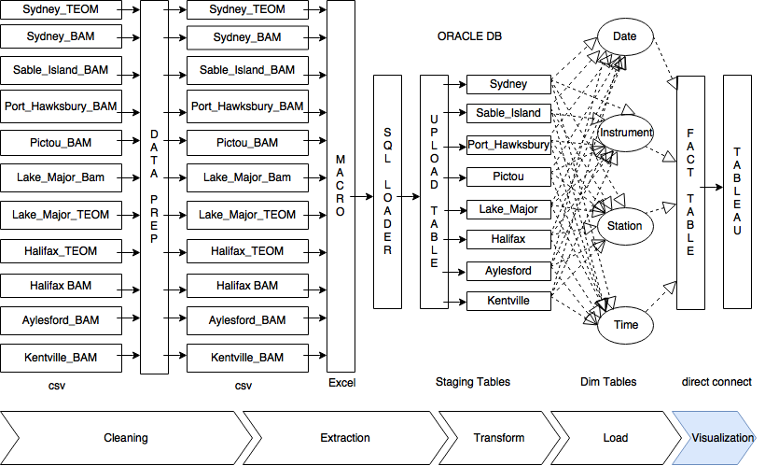

Slide 49
Visualization
Fact table and Dim tables from Oracle database connected directly to Tableau for visualization

